Slide 1


Slide 2
Minor I
Finding Optimal Route
A practical implementation of The Travelling Salesman Problem using Dynamic Programming
500069734 R134218123 Pratham Pandey
500068183 R134218125 Pulkit Mittal
500067543 R134218152 Shashwat Chitransh
500068730 R134218206 Karmanya Dadhich
Under the mentorship of
Dr. Jitendra Rajpurohit
Department of Systemics

Slide 3
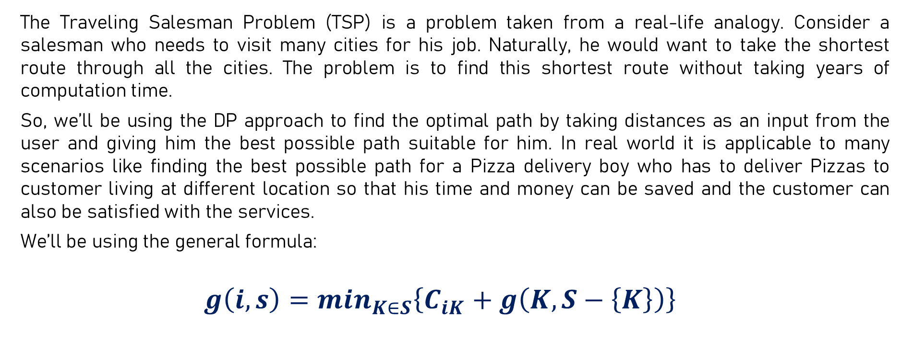
Introduction
The Traveling Salesman Problem (TSP) is a problem taken from a real-life analogy. Consider a salesman who needs to visit many cities for his job. Naturally, he would want to take the shortest route through all the cities. The problem is to find this shortest route without taking years of computation time.
So, we’ll be using the DP approach to find the optimal path by taking distances as an input from the user and giving him the best possible path suitable for him. In real world it is applicable to many scenarios like finding the best possible path for a Pizza delivery boy who has to deliver Pizzas to customer living at different location so that his time and money can be saved and the customer can also be satisfied with the services.
We’ll be using the general formula:
$$g\left(i,s\right)=\min_{K∈S}\left\{C_{iK}+g\left(K,S−\left\{K\right\}\right)\right\}$$

Slide 4
Mathematical model
1) Consider or choose the starting and ending point.
2) For every other vertex i other than the chosen one, find the minimum cost path with chosen vertex as the starting point, i as the ending point making sure all vertices appearing exactly once.
3) Finally, return the minimum of all [cost(i) + dist (i, chosen starting point)] values.
4) Find cost(i), define a term C (S, i) be the cost of the minimum cost path visiting each vertex in set S exactly once, starting vertex and ending at i.
5) Start with all subsets of size 2 and calculate C(S, i) for all subsets where S is the subset.
6) Calculate C(S, i) for all subsets S of size 3 and so on.
7) If size of S is 2, then S must be {chosen starting point, i},C(S, i) = dist(starting point, i).
8) Else if size of S is greater than 2, C(S, i) = min { C(S-{i}, j) + dis(j, i)} where j belongs to S, j != i and j != 1.
9) For a set of size n, consider n-2 subsets each of size n-1 such that all subsets don’t have nth in them.
10) Using the above recurrence relation, write dynamic programming-based solution.

Slide 5
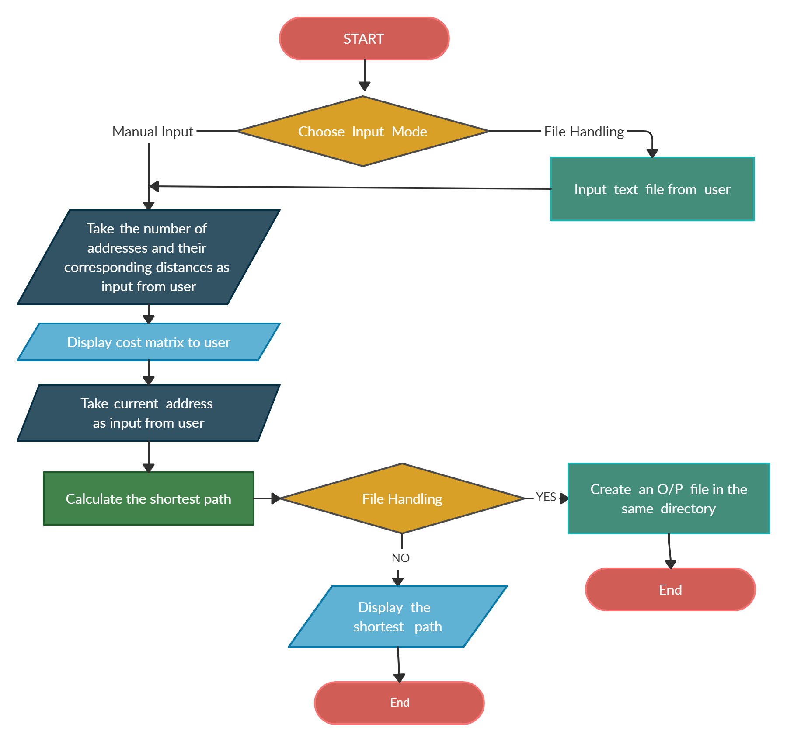
Flowchart

Slide 6
Implementation
Take input mode from user (File Handling / Manual input).
Take number of locations and their corresponding distances as input from user.
Create a distance matrix and display it to the user.
Take the initial location as input from user.
Find Min cost for the current node (through next node).
Repeat step 4 until completed.
Shortest path is calculated.
Display the shortest path to user or create an output file depending on user’s choice.

Slide 7
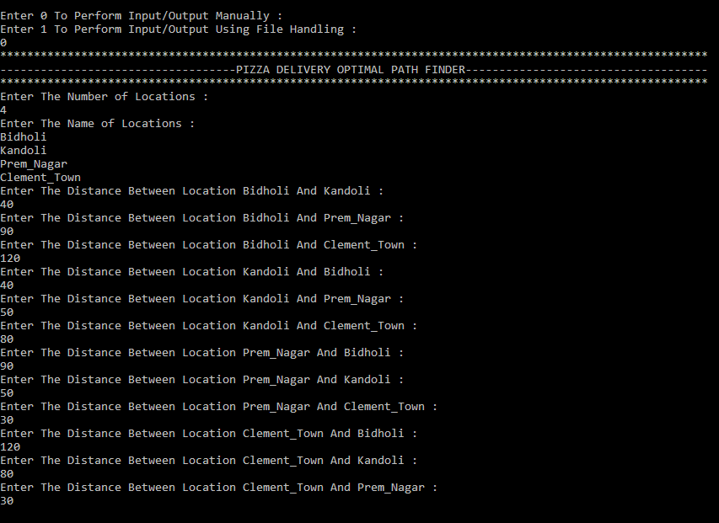
Output
Without File Handling:

Slide 8
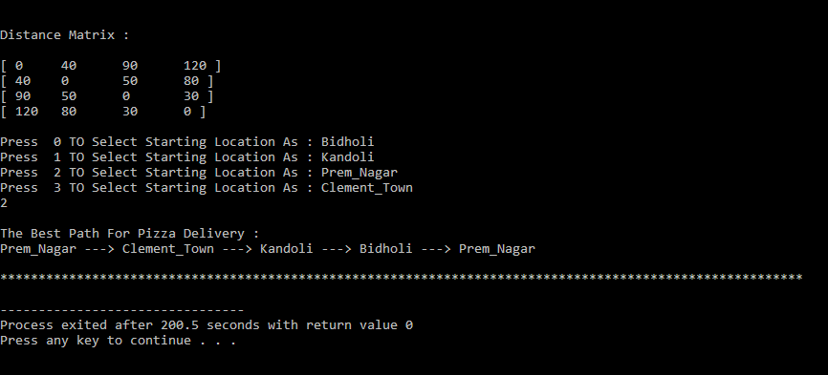

Slide 9
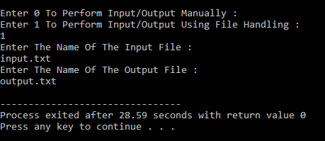
With File Handling:

Slide 10
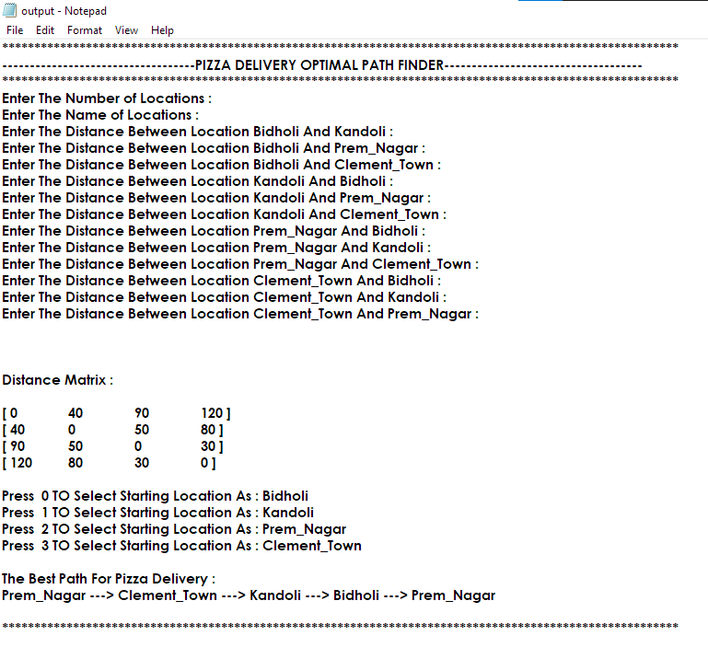
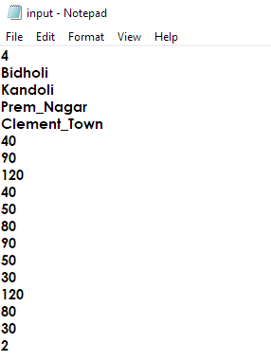
input.txt
output.txt

Slide 11
References
[1] D. L. Bixby, a new algorithm for finding a fuzzy optimal solution for fuzzy transportation problems, Applied mathematical sciences, 4, 79-90, 2012
[2] Cormen T. H., Design and Analysis of Algorithm, Operation research theory and application, Third Edition, 2007. [7] Zadeh L.A., Fuzzy sets Information and Control, 8, 3, 338-353, 1965.
[3] (2016) W.J. Cook, Tropical Complexity, Sidon Sets, and Dynamic Programming. SIAM Journal on Discrete Mathematics 30:4, 2064-2085.
[4] The Travelling Salesman Problem and Minimum Matching in the Unit Square. SIAM Journal on Computing 12:1, 144-156
[5]https://www.researchgate.net/publication/341123222_Traveling_salesman_problem_a_perspective_review_of_recent_research_and_new_results_with_bio-inspired_metaheuristic
[6] https://protosity.wordpress.com/2015/12/12/travelling-salesman-problem-and-genetic-algorithms/#

Slide 12
THANK YOU

